Slide 1

Notes:
Indianapolis Colts

Slide 2
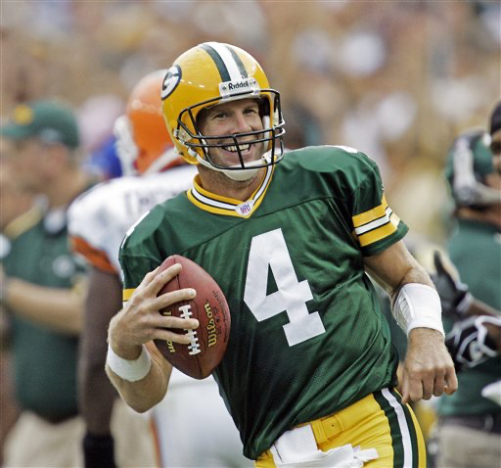
Notes:
Brett Favre

Slide 3
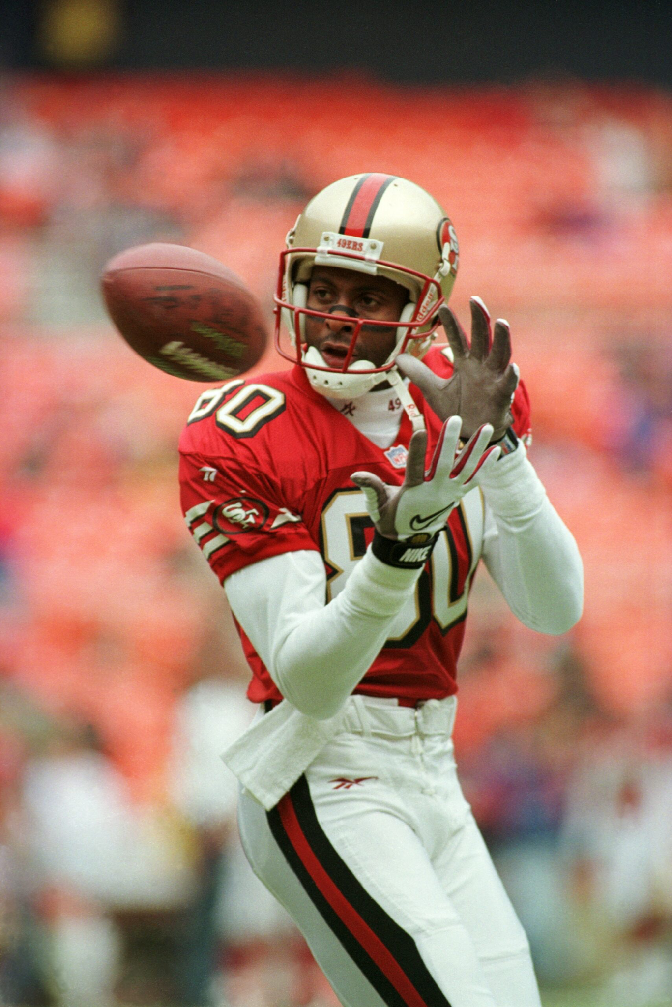
Notes:
Jerry Rice

Slide 4
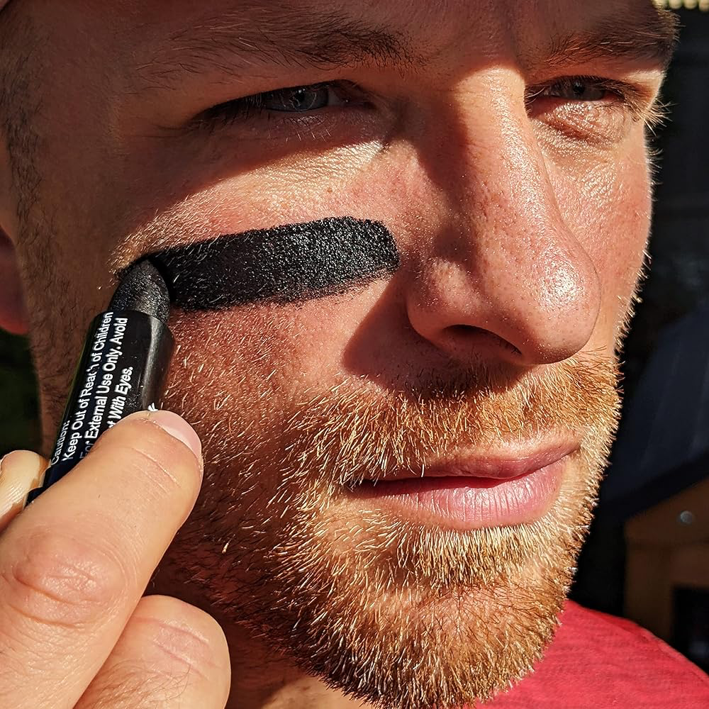
Notes:
Eye black

Slide 5
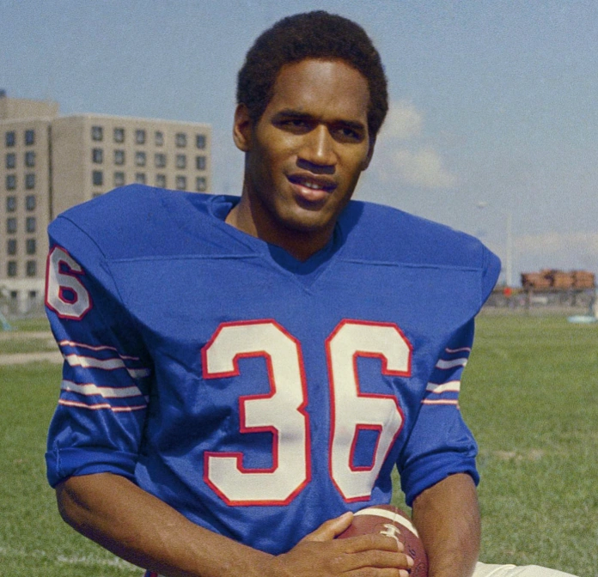
Notes:
OJ Simpson

Slide 6
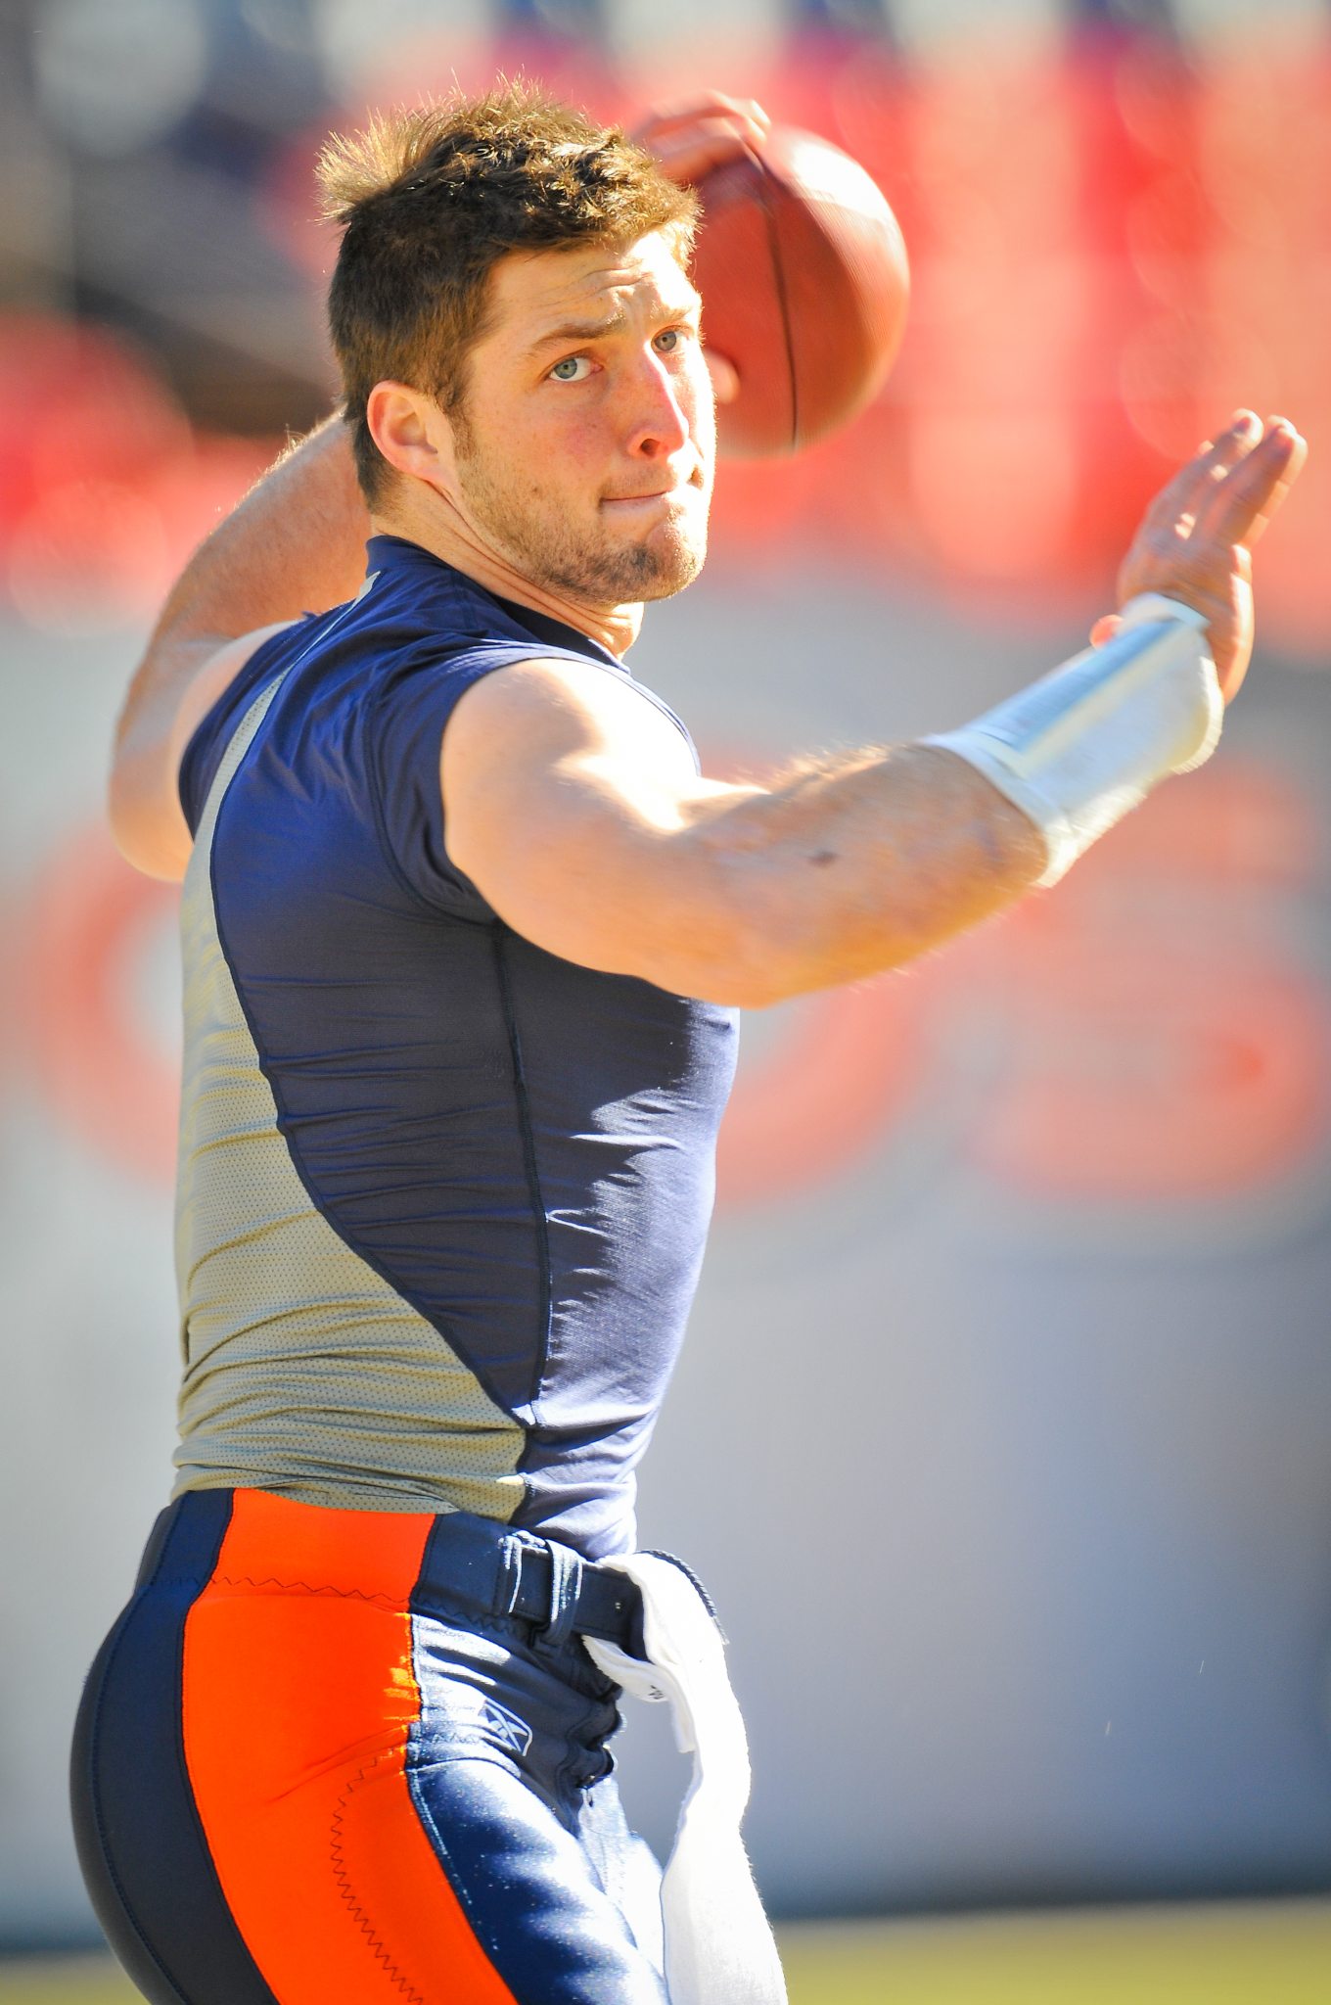
Notes:
Tim Tebow

Slide 7
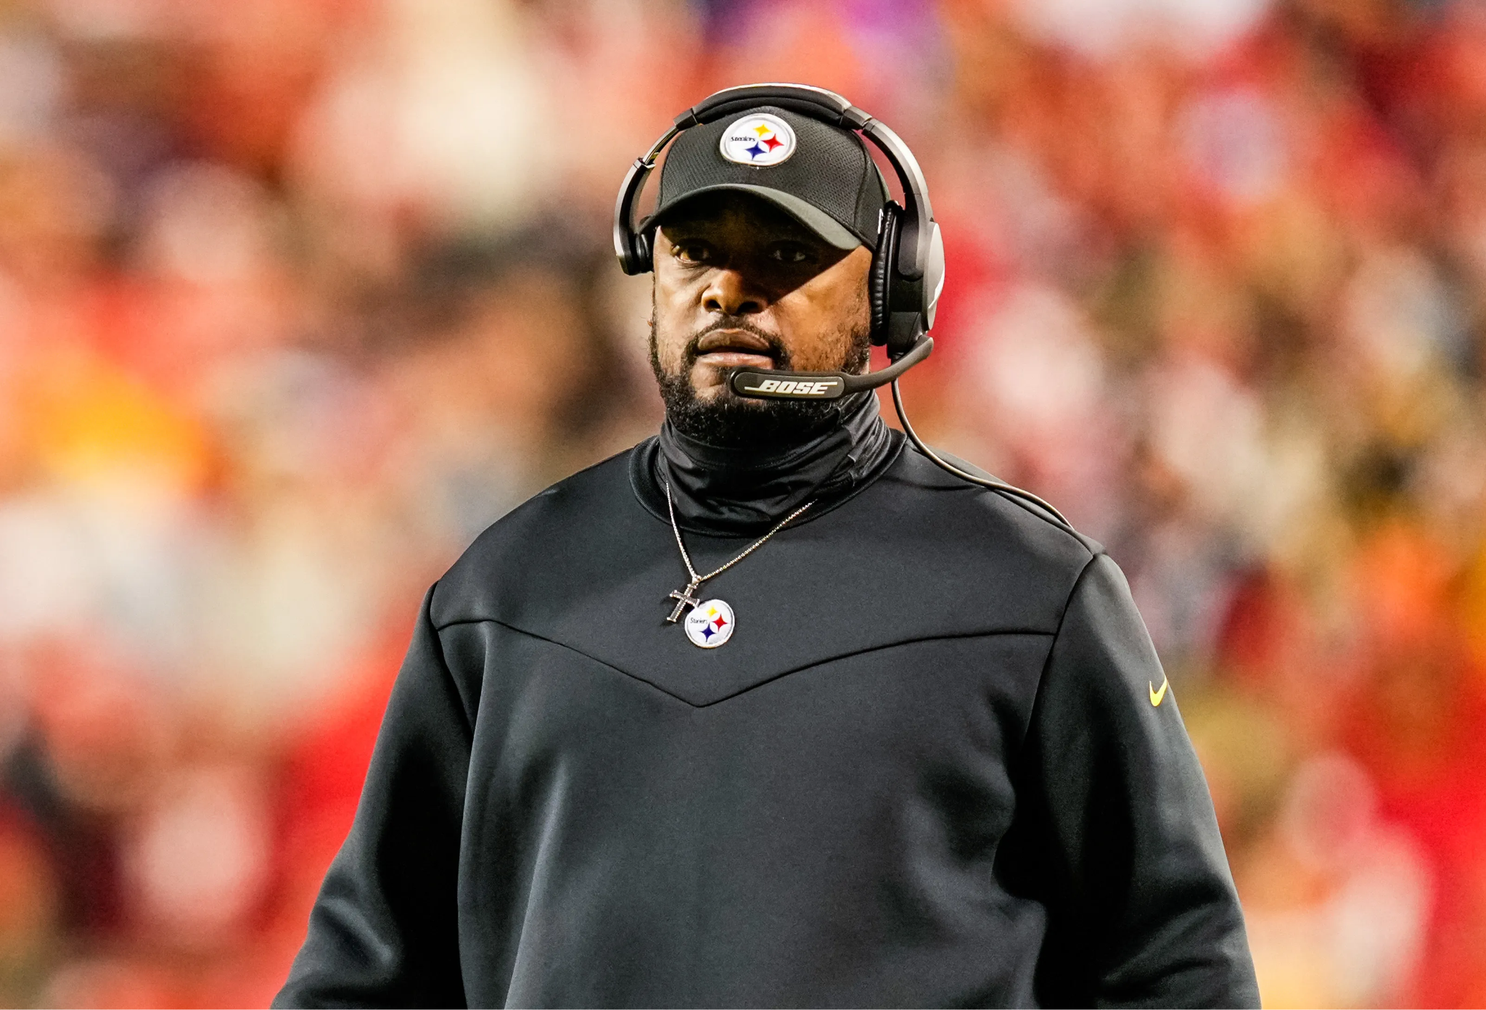
Notes:
Mike Tomlin

Slide 8
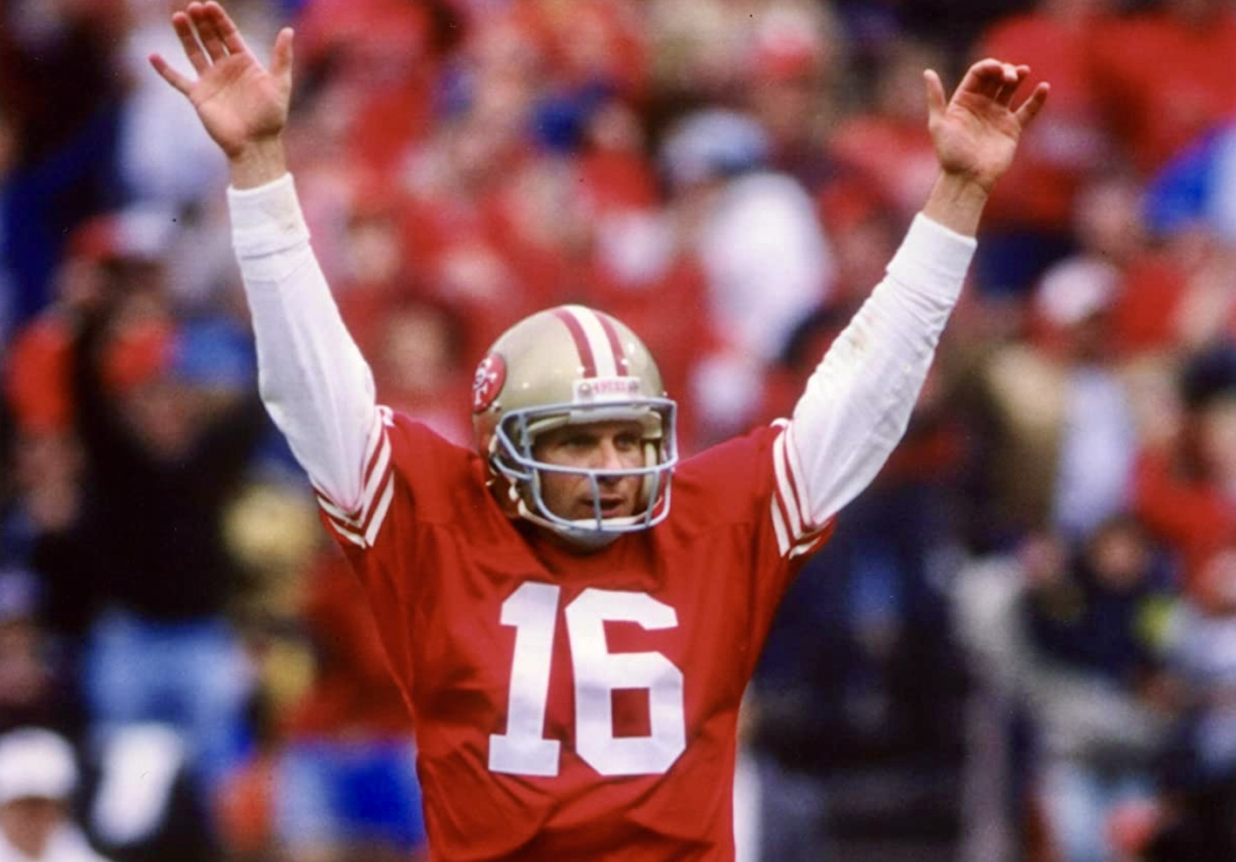
Notes:
Joe Montana

Slide 9
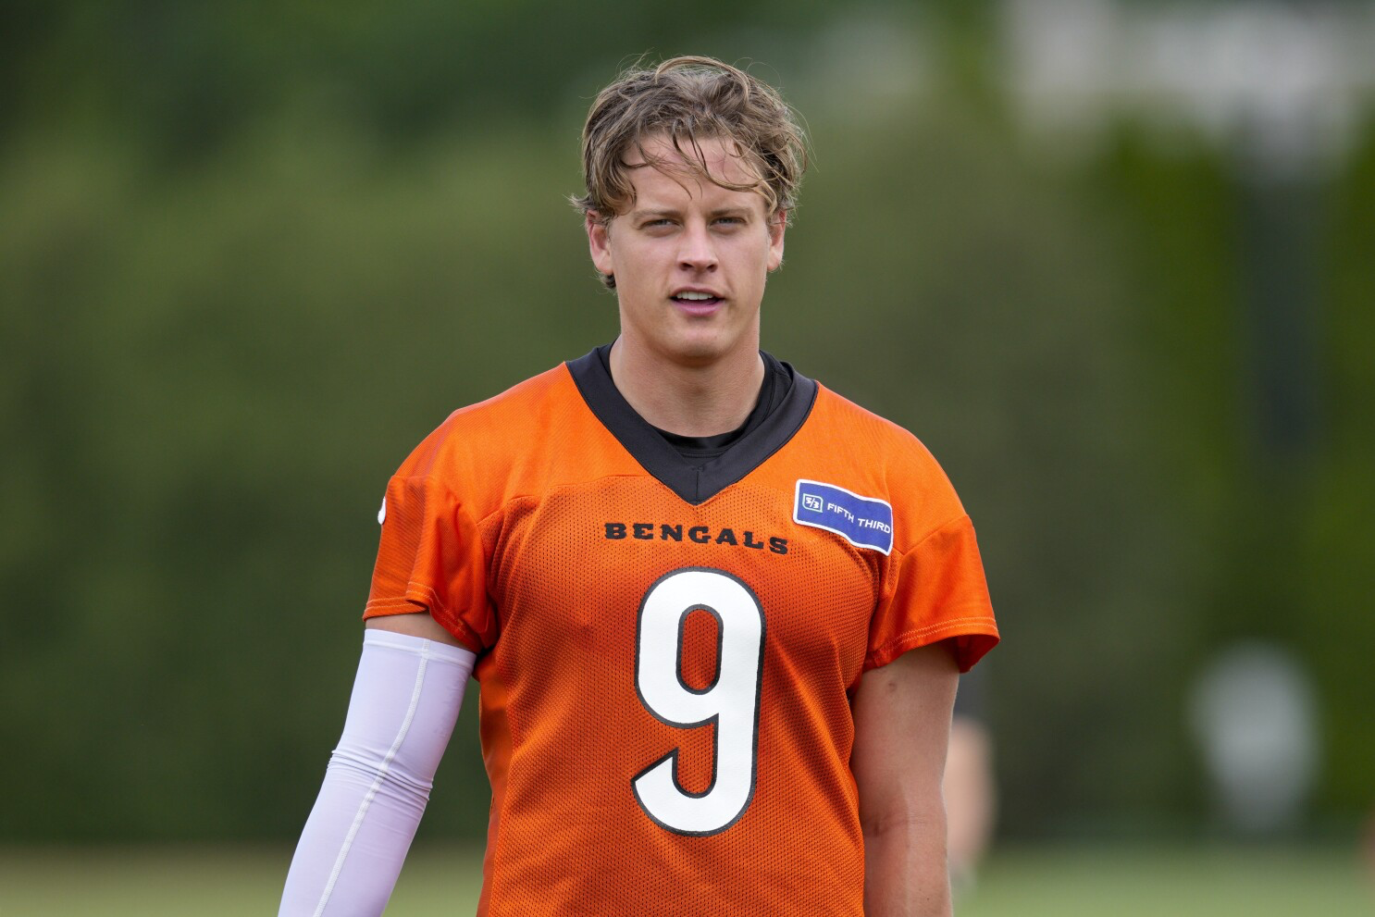
Notes:
Joe Burrow

Slide 10

Notes:
Atlanta Falcons

Slide 11
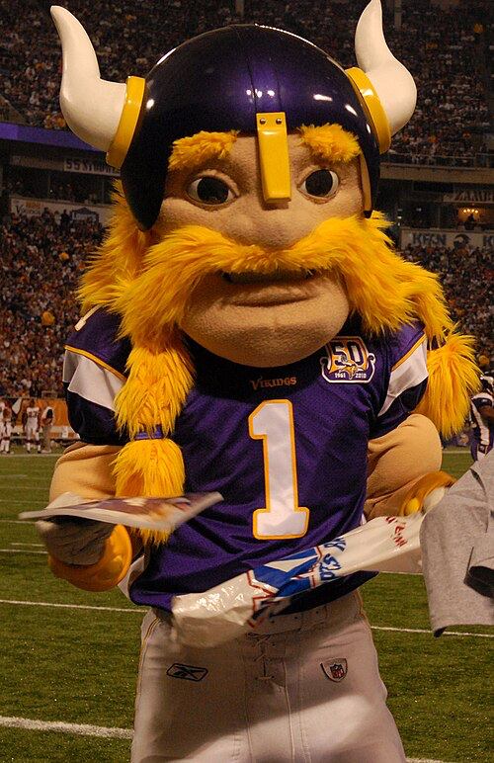
Notes:
Victor

Slide 12
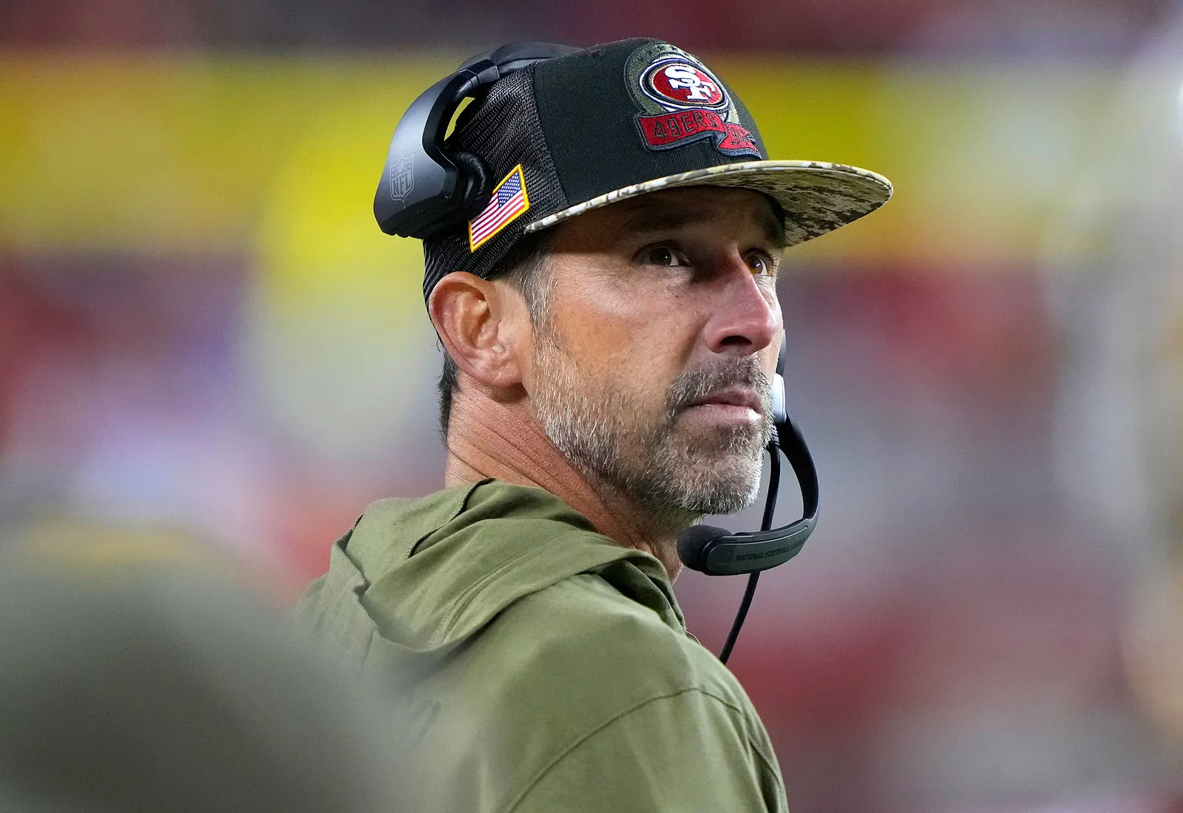
Notes:
Kyle Shanahan

Slide 13

Notes:
Buffalo bills

Slide 14
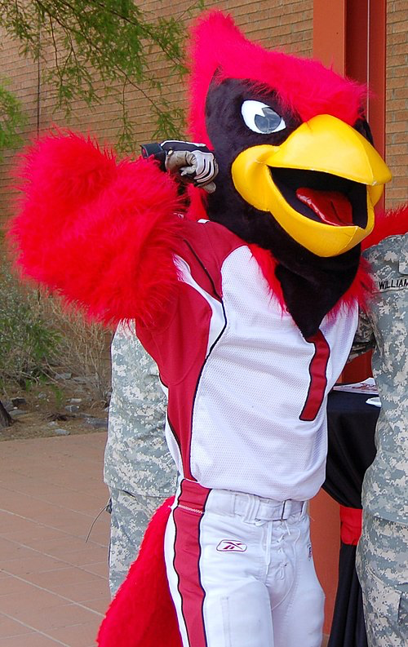
Notes:
Big Red

Slide 15
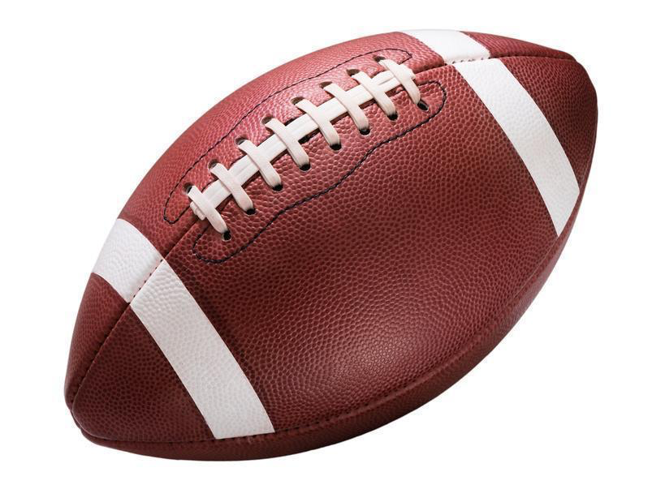
Notes:
football

Slide 16
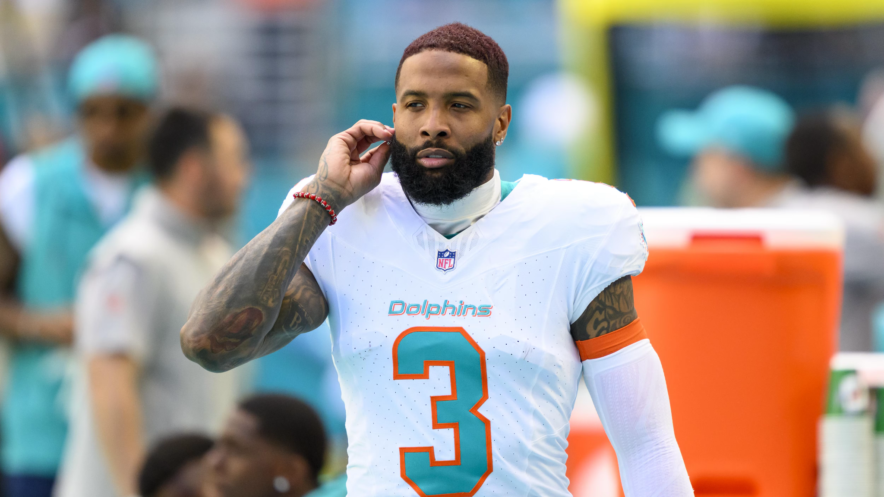
Notes:
Odell Beckham Jr

Slide 17
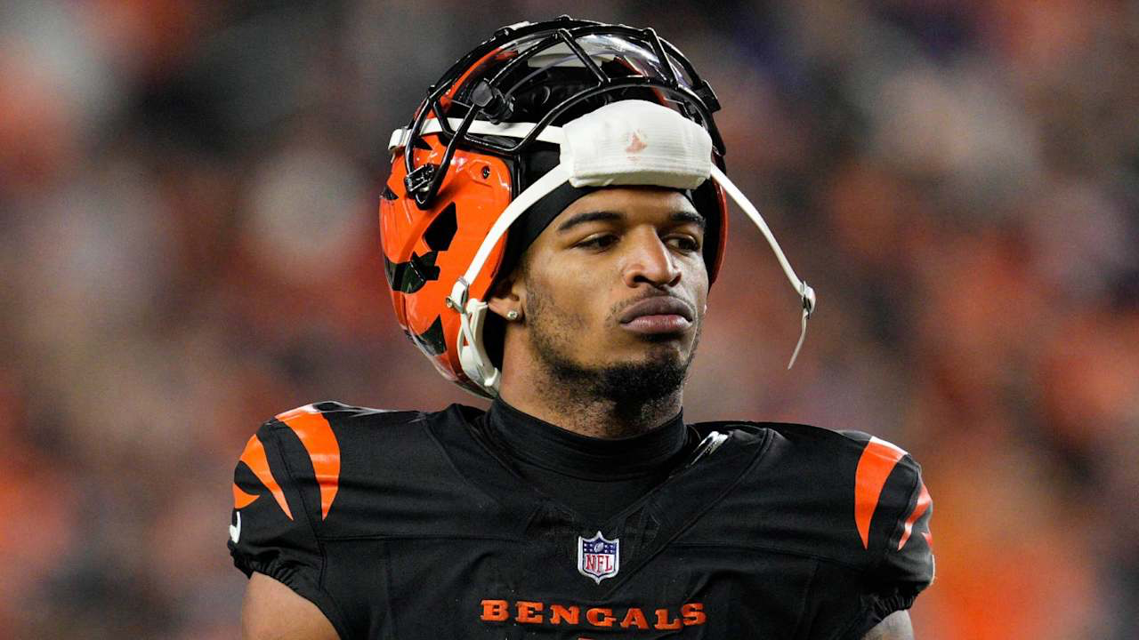
Notes:
Ja’Marr Chase

Slide 18
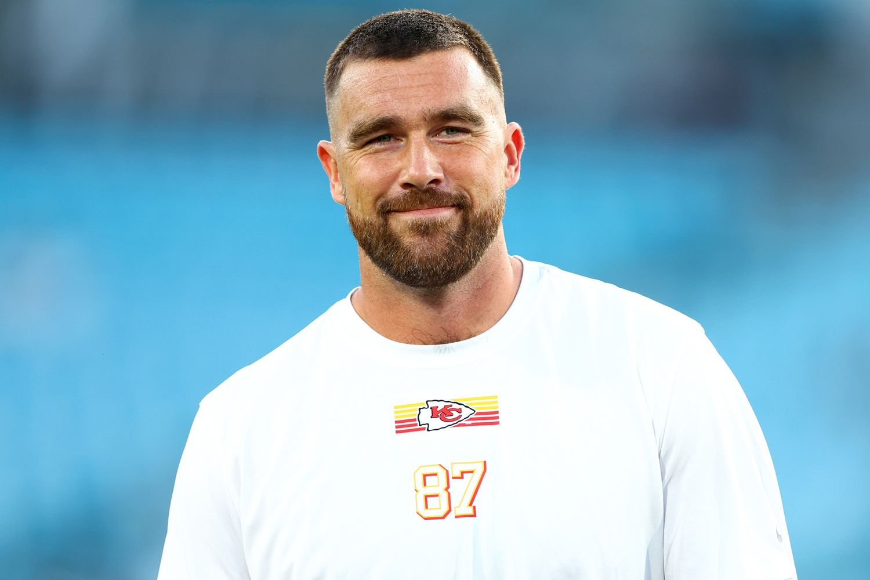
Notes:
Travis Kelce

Slide 19
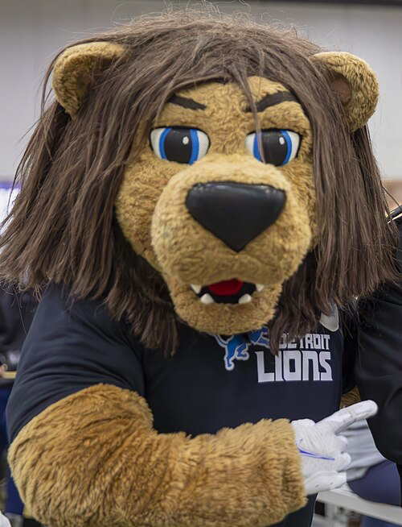
Notes:
Roary

Slide 20
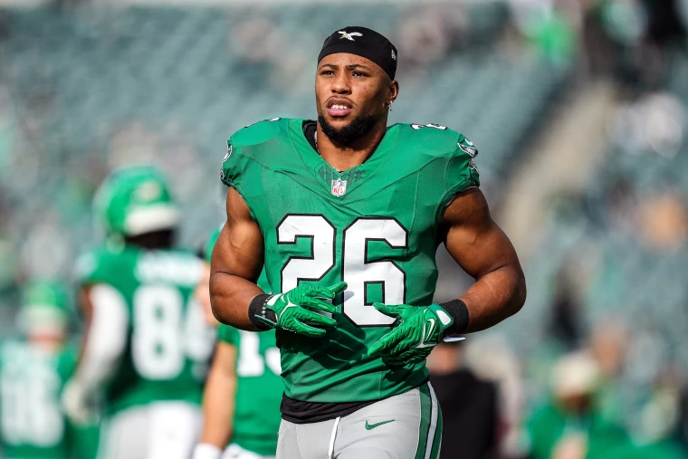
Notes:
Saquon Barkley

Slide 21
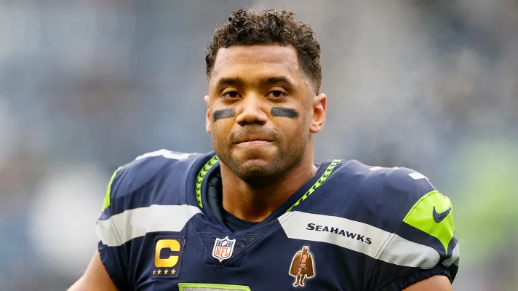
Notes:
Russell Wilson

Slide 22
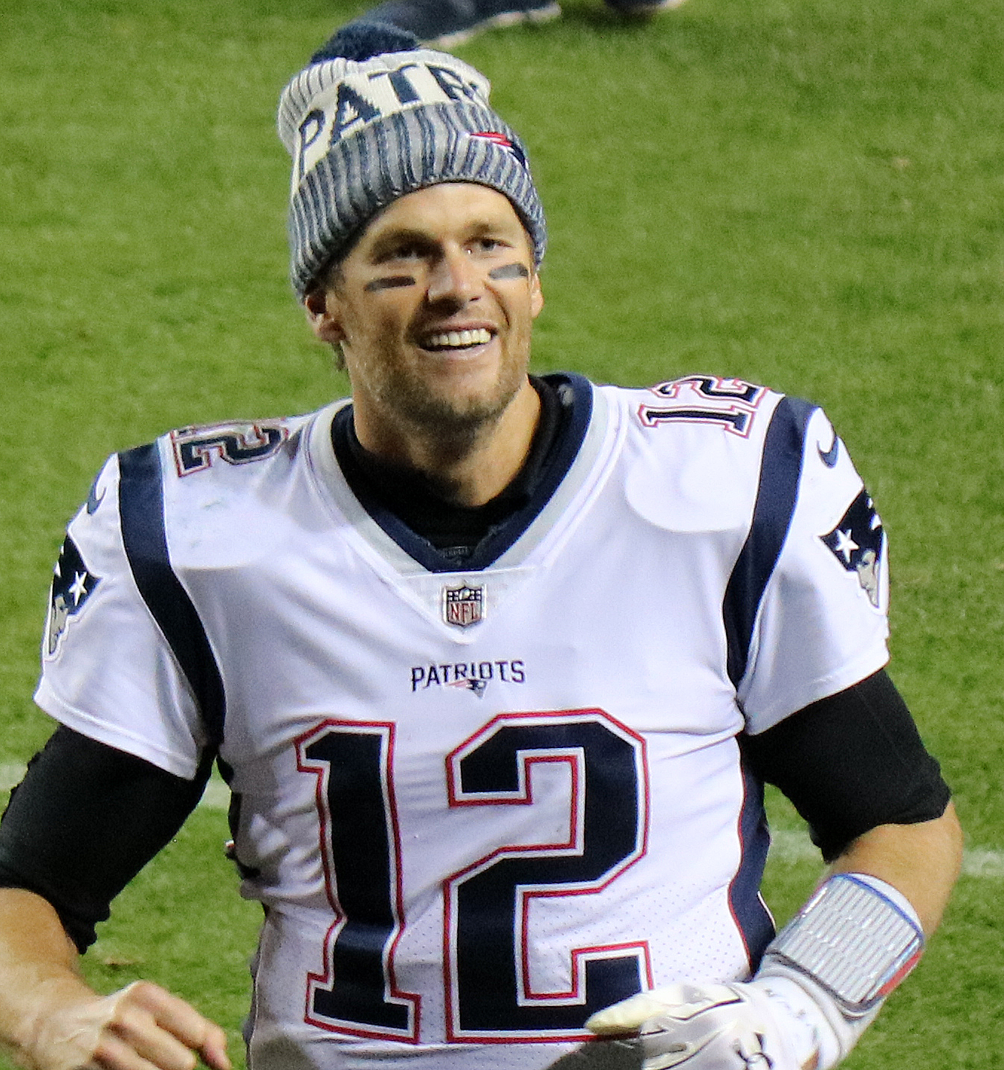
Notes:
Tom Brady

Slide 23
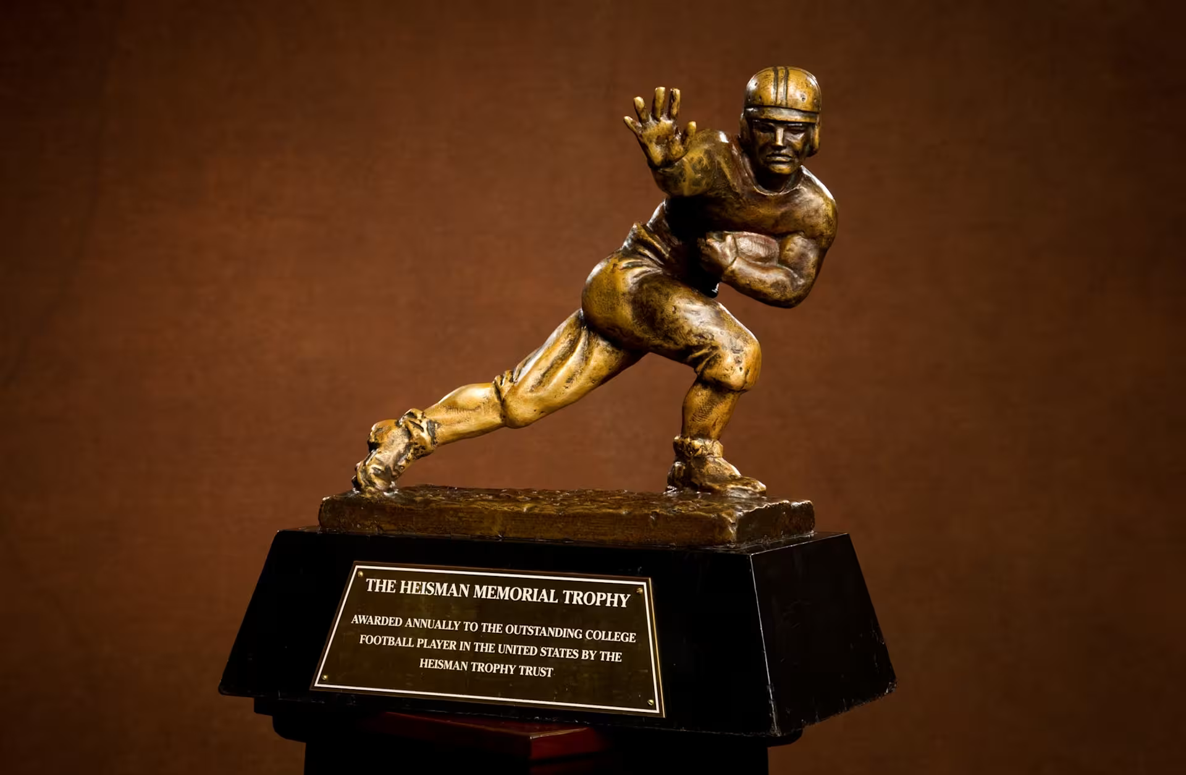
Notes:
Heisman Trophy

Slide 24
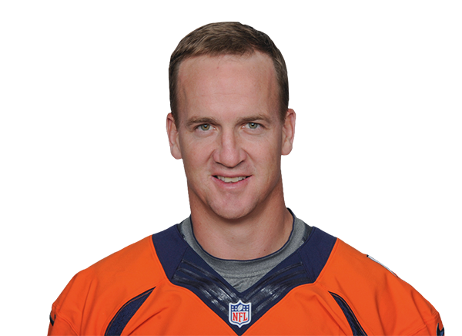
Notes:
Peyton Manning

Slide 25
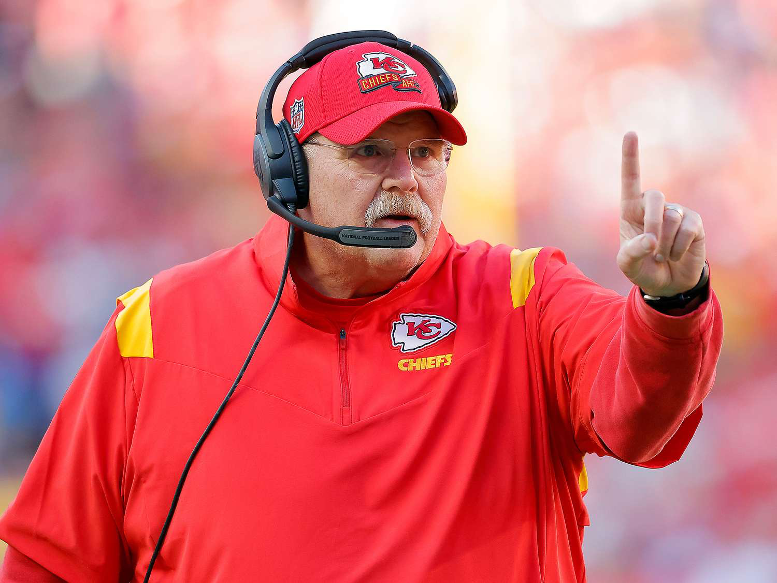
Notes:
Andy Reid

Slide 26
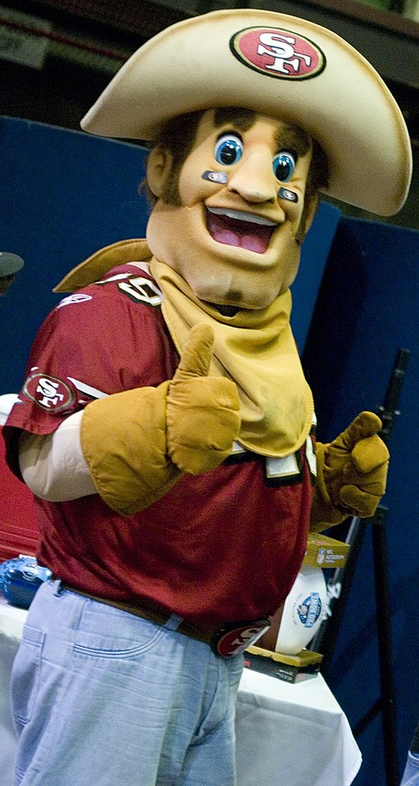
Notes:
Sourdough Sam

Slide 27
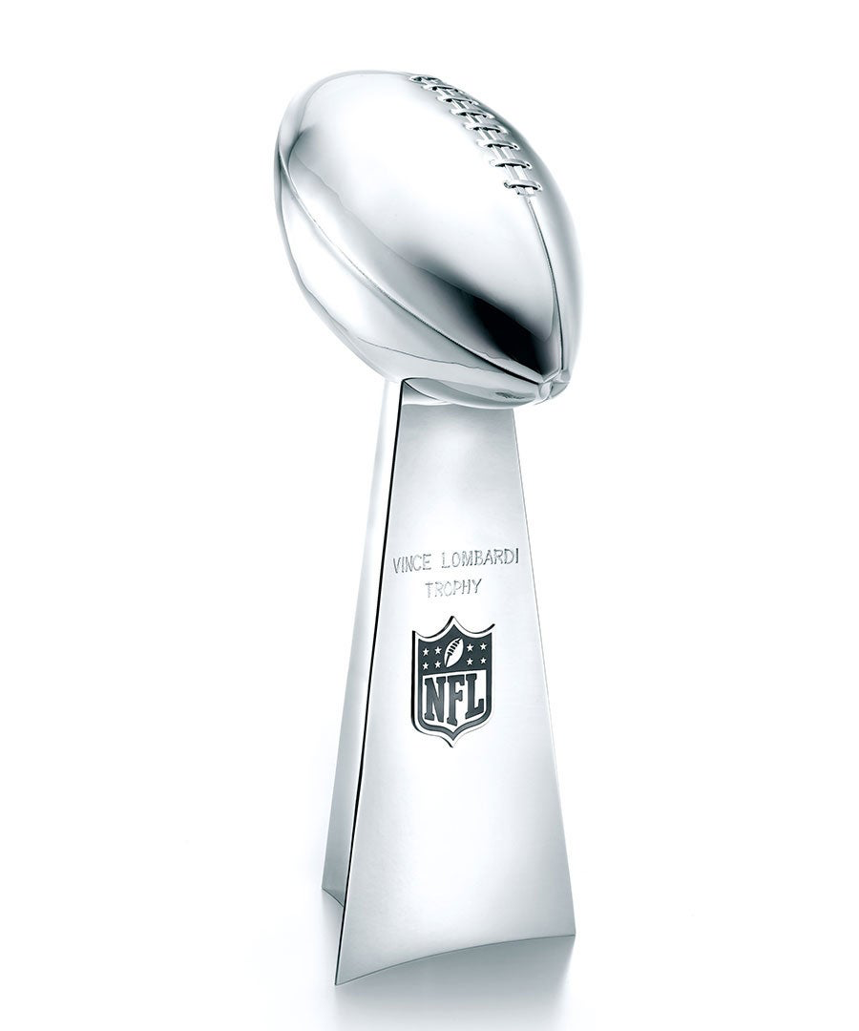
Notes:
Vince Lombardi Trophy

Slide 28
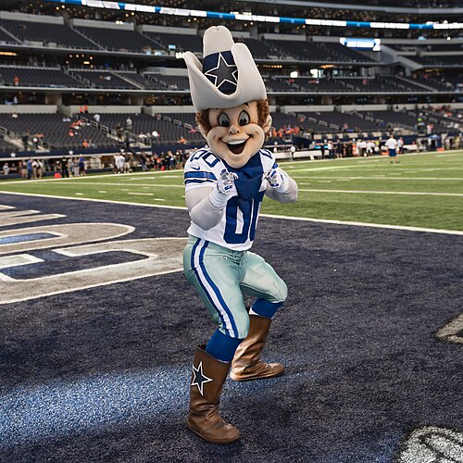
Notes:
Rowdy

Slide 29

Notes:
Denver Broncos

Slide 30
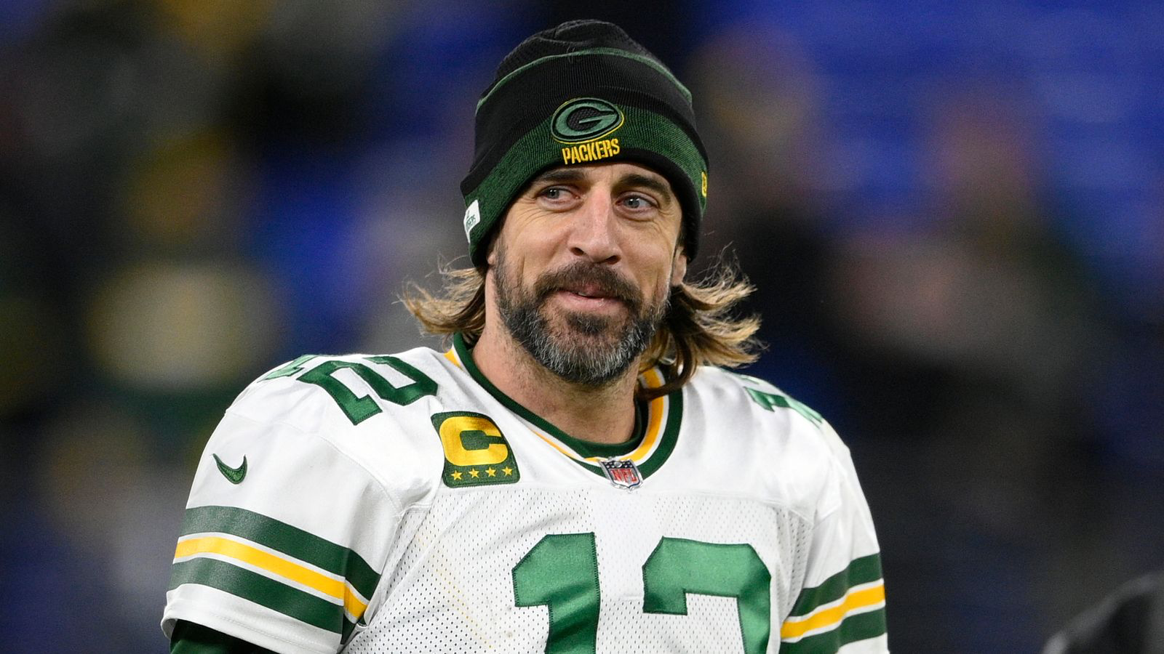
Notes:
Aaron Rodgers

Slide 31

Notes:
Washington Commanders

Slide 32

Notes:
Houston Texans

Slide 33
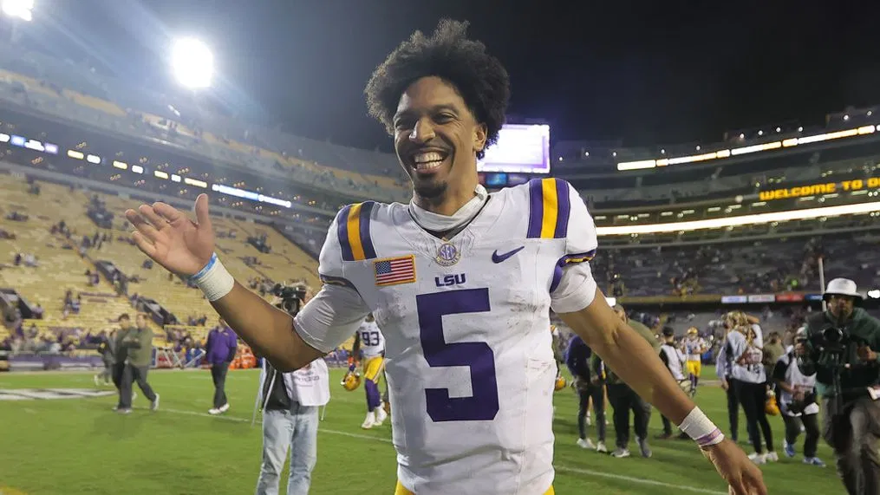
Notes:
Jayden Daniels

Slide 34

Notes:
Tennessee Titans

Slide 35
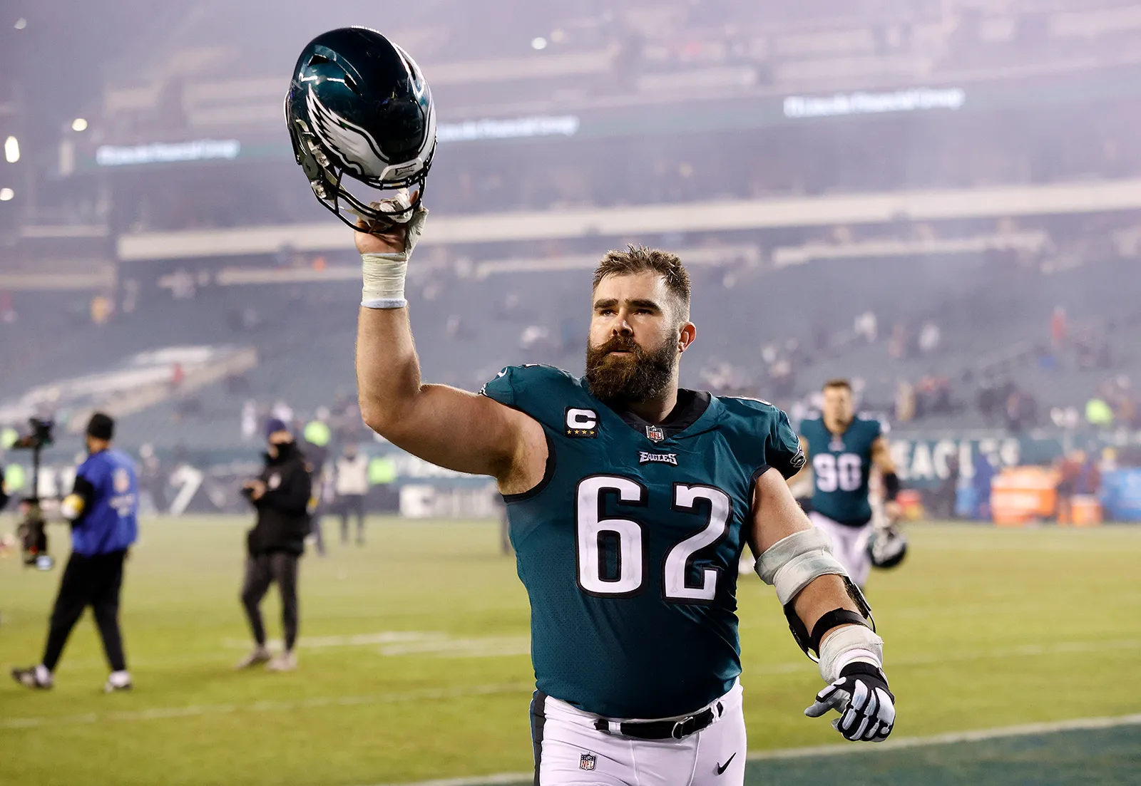
Notes:
Jason Kelce

Slide 36
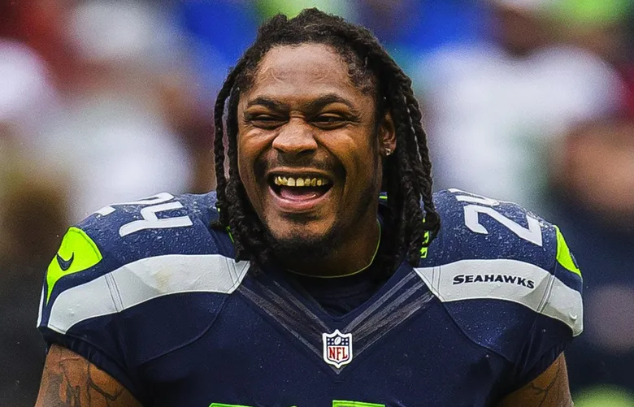
Notes:
Marshawn Lynch

Slide 37
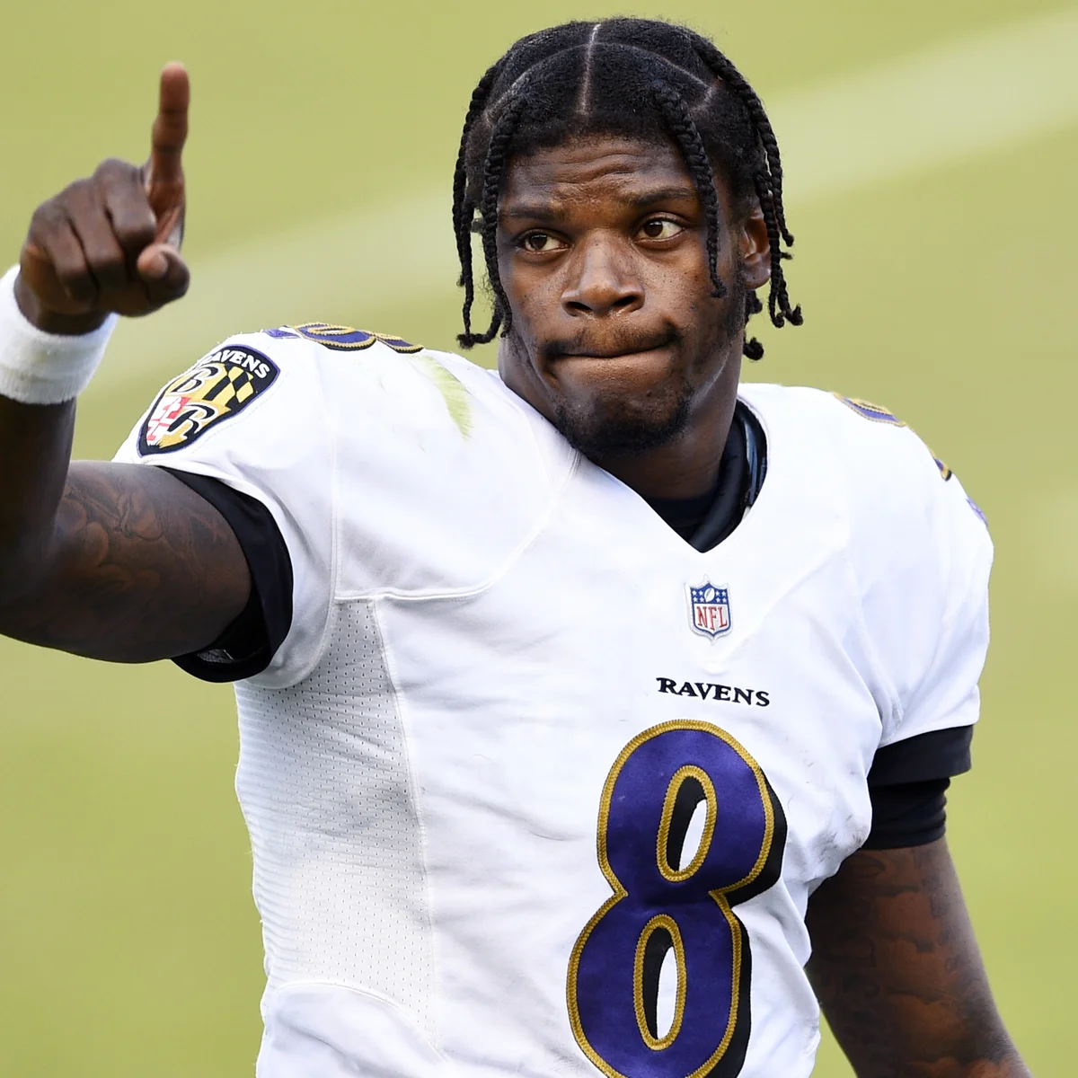
Notes:
Lamar Jackson

Slide 38
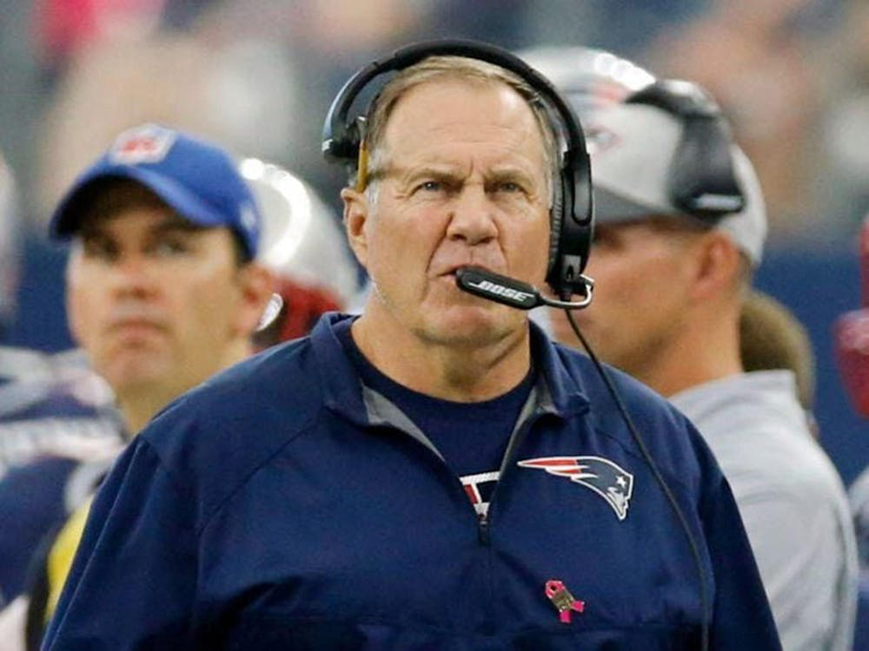
Notes:
Bill Belichick

Slide 39
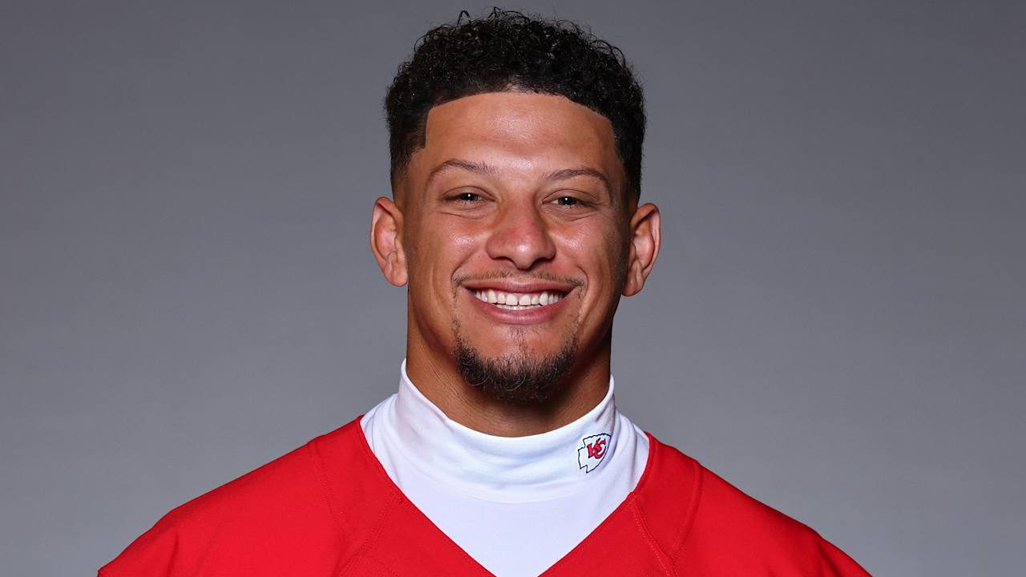
Notes:
Patrick Mahomes

Slide 40
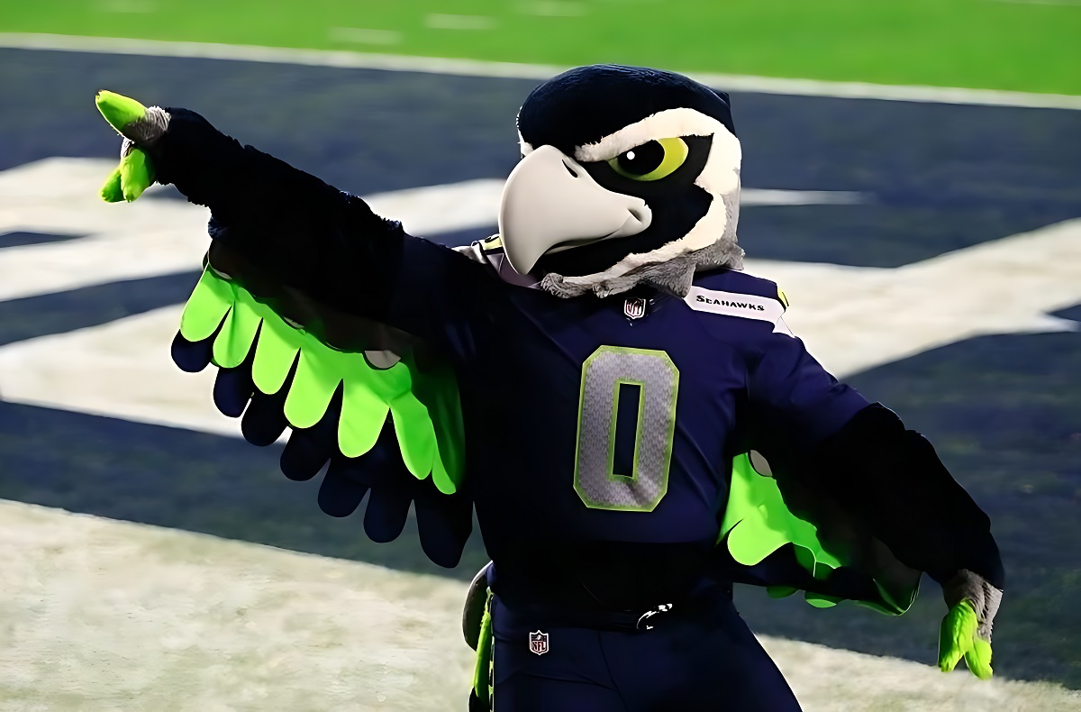
Notes:
Blitz

Slide 41
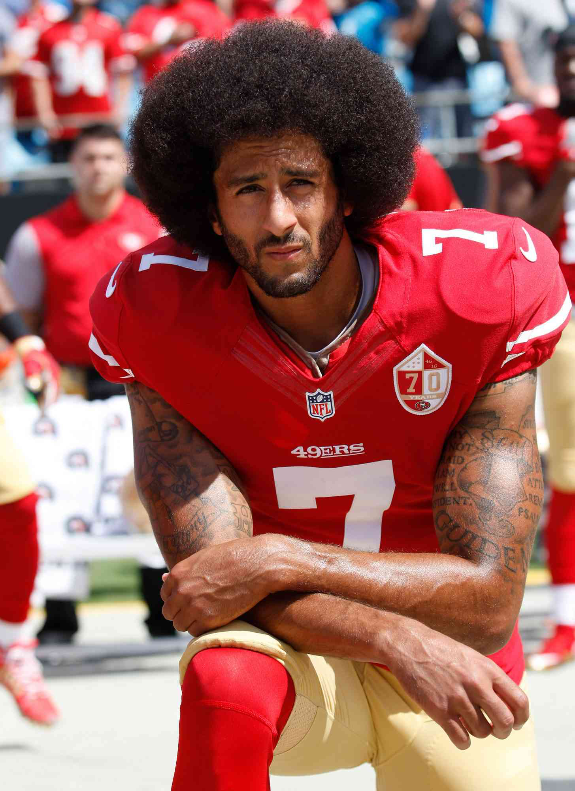
Notes:
Colin Kaepernick

Slide 42
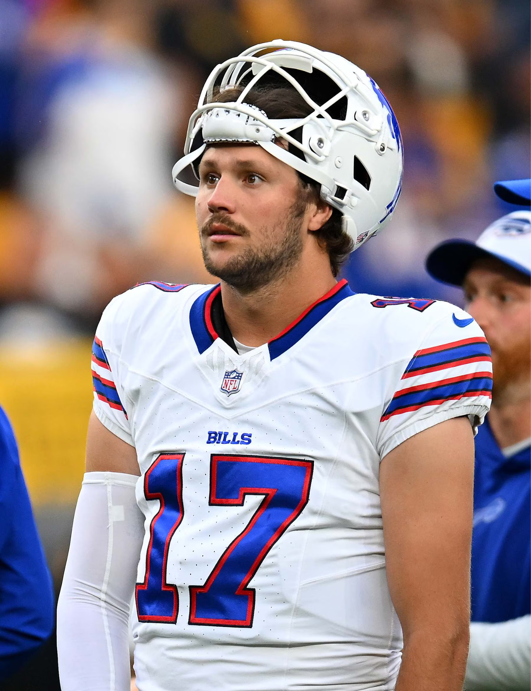
Notes:
Josh Allen

Slide 43

Notes:
Tampa Bay Buccaneers

Slide 44
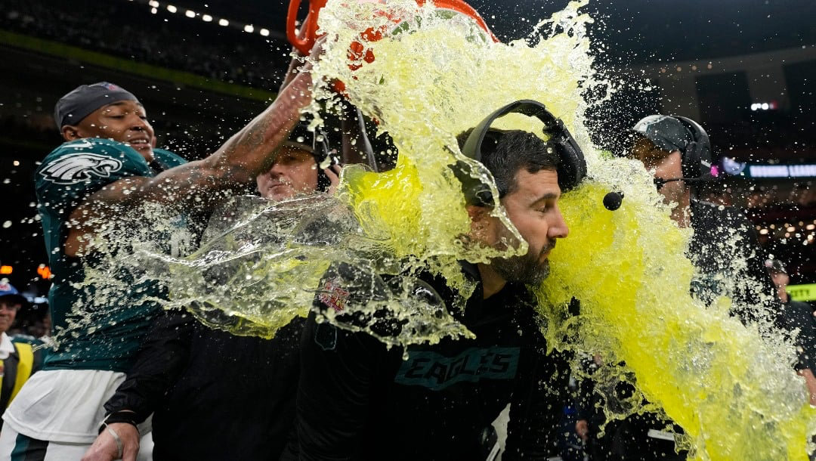
Notes:
gatorade

Slide 45
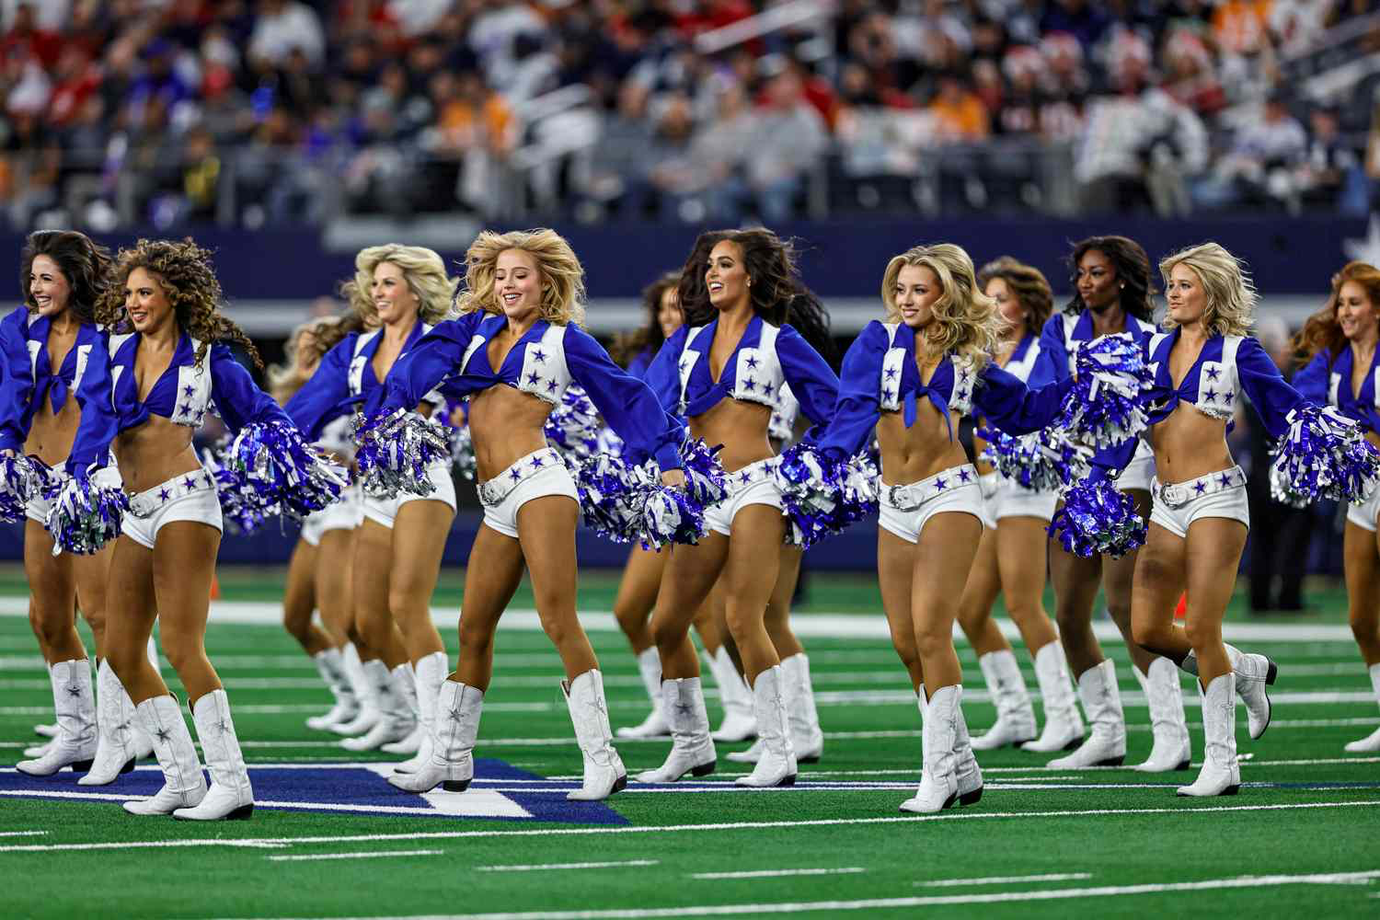
Notes:
Dallas Cowboys Cheerleaders

Slide 46

Notes:
New Orleans Saints

Slide 47
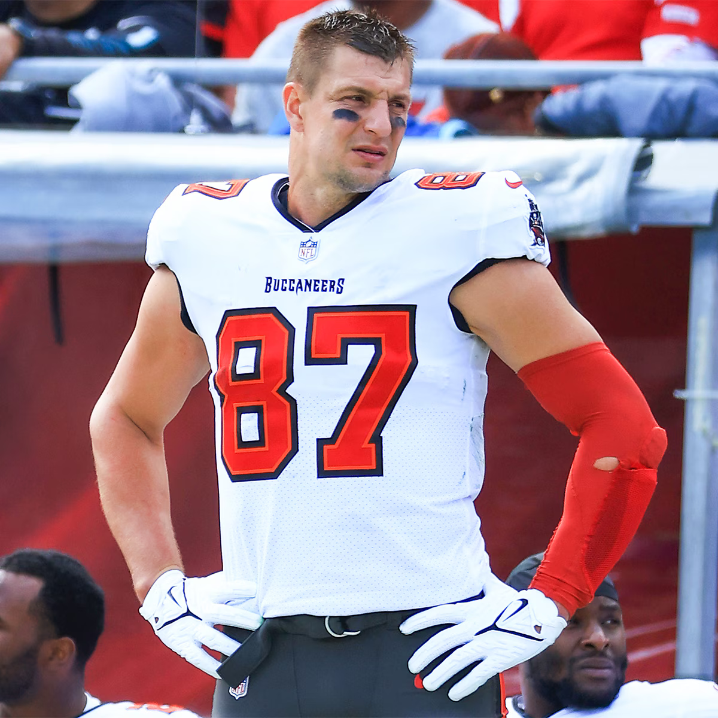
Notes:
Rob Gronkowski

Slide 48
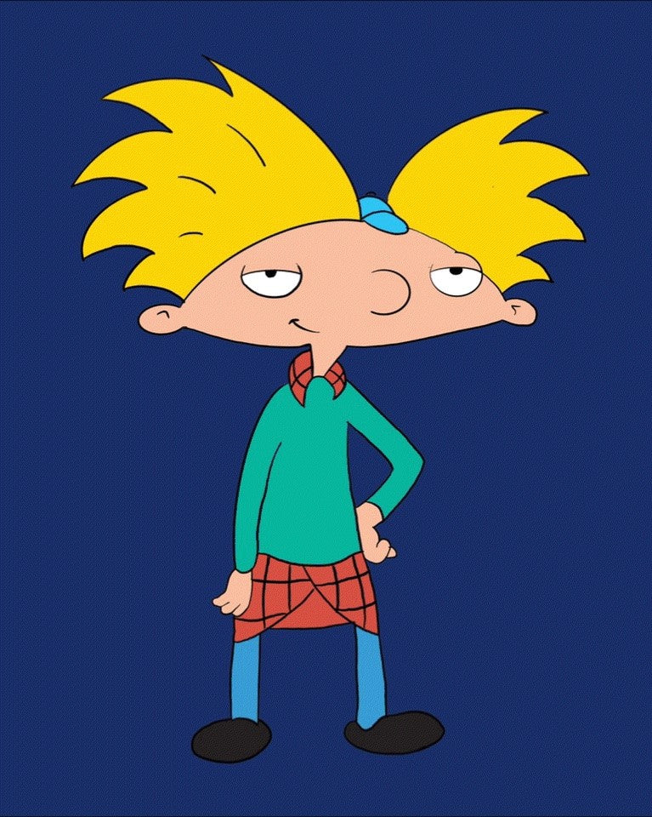
Notes:
Hey Arnold

Slide 49
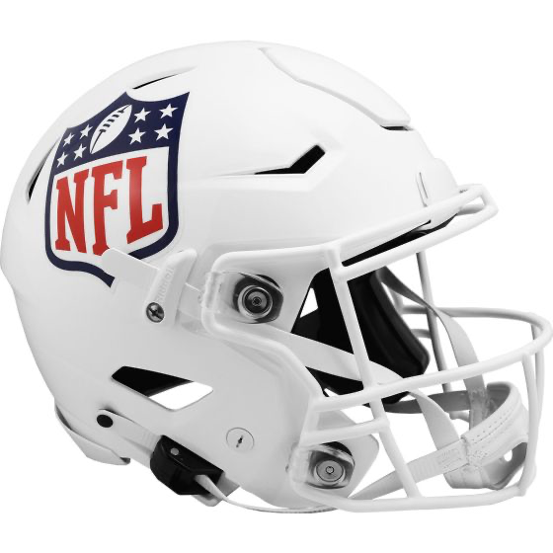
Notes:
Helmet

Slide 50
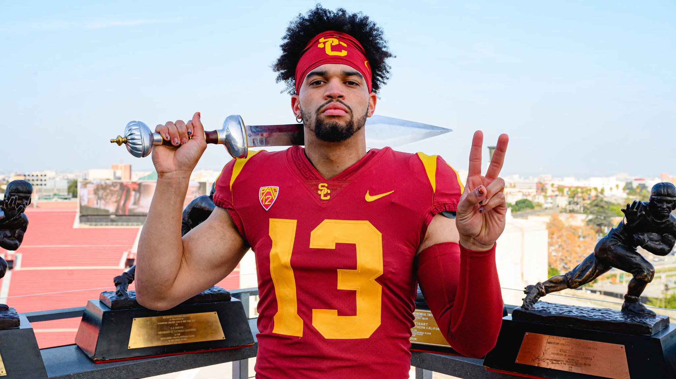
Notes:
Caleb Williams

